Slide 1
Module 1: Lesson 2 – Conservational Tillage

Slide 2
Review of Conventional tillage
What is the difference between Primary and Secondary Tillage?
Give one example of an implement used in primary tillage and one example of an implement used in secondary tillage

Slide 3
Conventional vs Conservational Tillage
Conventional Tillage – a Tillage system that fully disturbs the soil to create a smooth seedbed
Conservational Tillage – a Tillage system that leaves at least 30% of the soil covered with crop residue after planting
Both Conventional and Conservational tillage have their advantages and disadvantages

Slide 4
Conservational tillage
The goal of conservational tillage is the disturb the soil as little as possible to reduce soil erosion and improve soil health
Common Methods
No Tillage – seeds are planted directly into untilled soil
Vertical Tillage – shallow vertical soil cutting that doesn’t turn the soil
Strip Tillage – only narrow strips of the field are tilled for planting
What is Sustainable Agriculture? Episode 3: Conservation Tillage and Soil Health
Notes:
Ask Students-
Q: before we go any farther, can anyone think of any advantages or disadvantages of using conservational tillage? Just based on what we know of conventional tillage
A: Possible answers
Advantages: Reduces Soil Erosion – Crop residue protects the soil. Improves Soil Health – Increases organic matter and soil structure. Enhances Moisture Retention – Reduces evaporation, helping crops in dry conditions. Lowers Fuel & Labor Costs – Fewer field passes mean less equipment use.
Disadvantages: May require increased herbicide use for weed control.
Cooler, wetter soils in spring can delay planting.

Slide 5
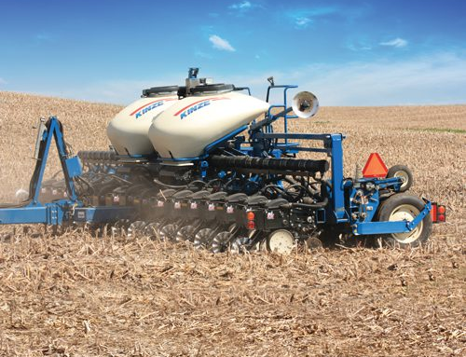
No-Till
Seeds are planted directly into untilled soil
Used in all major row crops in conservation farming
Advantages: Preserves soil moisture, less passes over the field, saved fuel costs
Disadvantages: Residue buildup can slow plant emergence, may require herbicides for weed control
Farm Basics #1029 The Pros And Cons Of No-Till (Air Date 12-24-17)

Slide 6
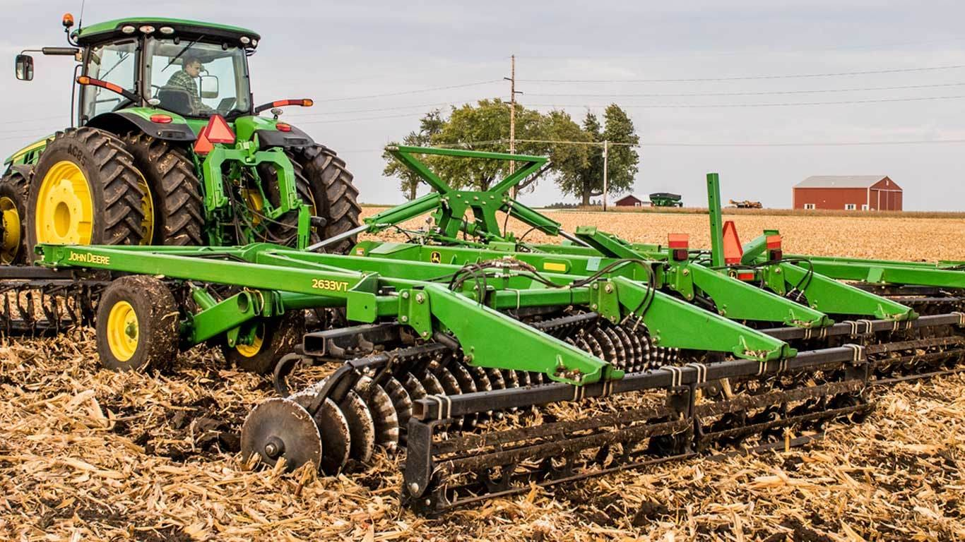
Vertical Tillage
Uses straight, shallow rolling blades to manage residue without turning over soil
Best used for preparing soil while keeping residue on the surface
Advantages: Reduces erosion while improving residue breakdown
Disadvantages: Does not address deep compaction layers
https://www.extension.iastate.edu/digitalag/video-benefits-using-vertical-tillage-tool

Slide 7
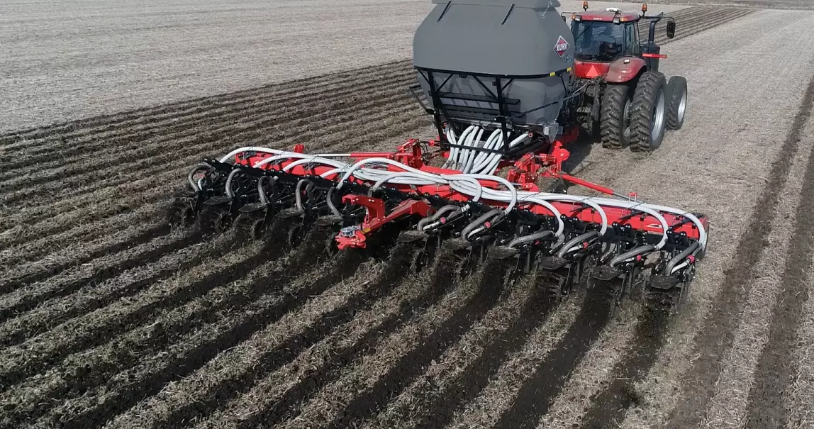
Strip-Tillage
Tills narrow strips while leaving most soil undisturbed
Best used for row crops like corn and soybeans and in fields with heavy residue
Advantages: Reduced runoff and soil loss, allows for precise placement of fertilizers
Disadvantages: specialized equipment can be expensive
https://www.youtube.com/watch?v=Iqwb1ZnzMLg
Farm Basics # 1073 What Is Strip Tillage? (Air Date 10-28-18)

